Slide 1
Initiation Hackathon
27th of August 2022

Slide 2
Contents
Introduction to the hackathon
Challenges
General rules
Mini-lecture: Tanks
Arduino basics and setup
Motor speed control
Sensor usage
Serial communication wired and bluetooth

Slide 3
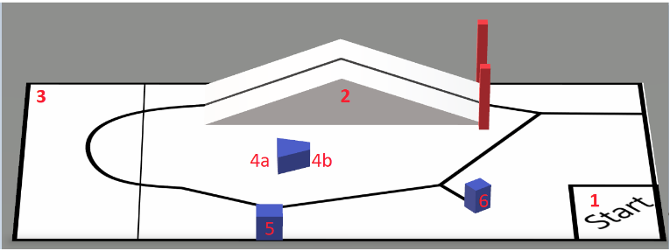
Hackathon game field
Start/finish area
Ramp
Chip placement area
Wide and narrow gap obstacle
Large box
Small box

Slide 4
Challenges

Slide 5
Mechanical challenges
Ramp climbing(2)
Uphill -> 10 pts
Downhill -> 5 pts
Chip pushing(3)
Wide gap -> 10 pts
Narrow gap -> 20 pts
Double if autonomous
Ping-pong ball dropping(5 & 6)
Small box -> 20 pts
Big box -> 15 pts
Double if autonomous

Slide 6
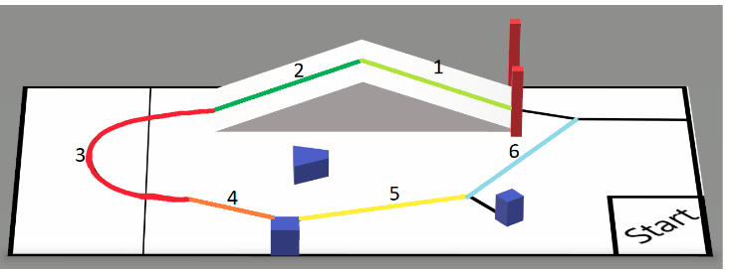
Line-following challenges
Main software task
Every piece of the path independently gives points
Section 1 -> 20
Section 2 -> 10
Section 3 -> 20
Section 4 -> 10
Section 5 -> 10
Section 6 -> 10
1 means ‘uphill’ and 2 downhill independent of the direction of approaching the ramp
PENALTY: -5 pts per section if you miss the line. Errors are only penalized once per section.

Slide 7
Competition rules
Finishing fully inside area 1 -> 20 pts if at least 5 pts of other tasks are gained.
Finishing partially inside area 1 -> 10 pts
Partially outside -> 5 pts
The ping-pong balls must be placed on top of the robot or inside the starting area
Starting outside of area 1 is allowed with a penalty of 5 pts
Each run has a max duration of 3 minutes
Run finishes when:
Team member touches the robot
Time runs out

Slide 8
General rules
Every team gets 2 ping-pong balls and 2 RSA chips to use in each run.
Repositioning the sensors is allowed as long as they are not permanently attached or glued to the tank
The robot is not allowed to damage the game field
You are allowed to use building materials found in the workshop to complete the mechanical challenges
You are allowed to have unlimited ungraded test runs on the game field.
Be respectful when testing on the game field. Don’t keep others waiting too long to test.

Slide 9
General rules
Each team gets at most 5 graded runs throughout the day. These are optional except 1 run during the finals, which is mandatory.
There are three graded sessions
Lunch -> 12:30
Afternoon -> 14:30
Final -> 18:00
You are not allowed to modify the code or add more building materials in between graded runs. Except tape if something needs to be taped again.
You have to register your runs at every session. At least 10 mins before your run, register on the run-sheet.
The score will be the highest score achieved among your runs. If there is a tie, the fastest time will break the time.

Slide 10
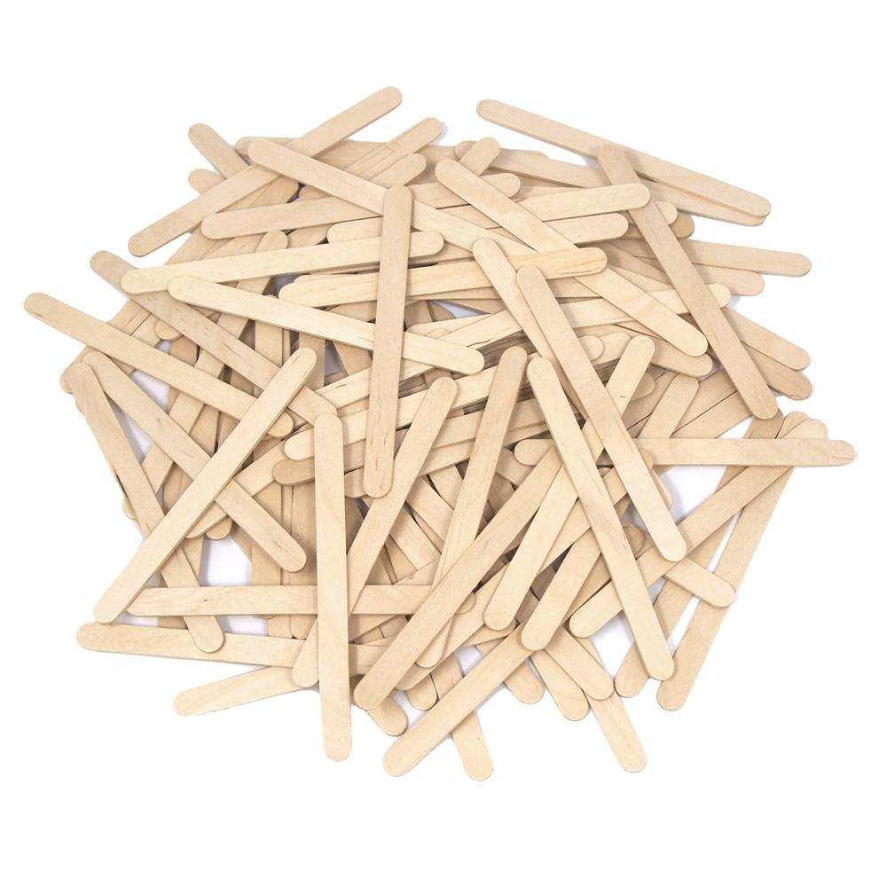
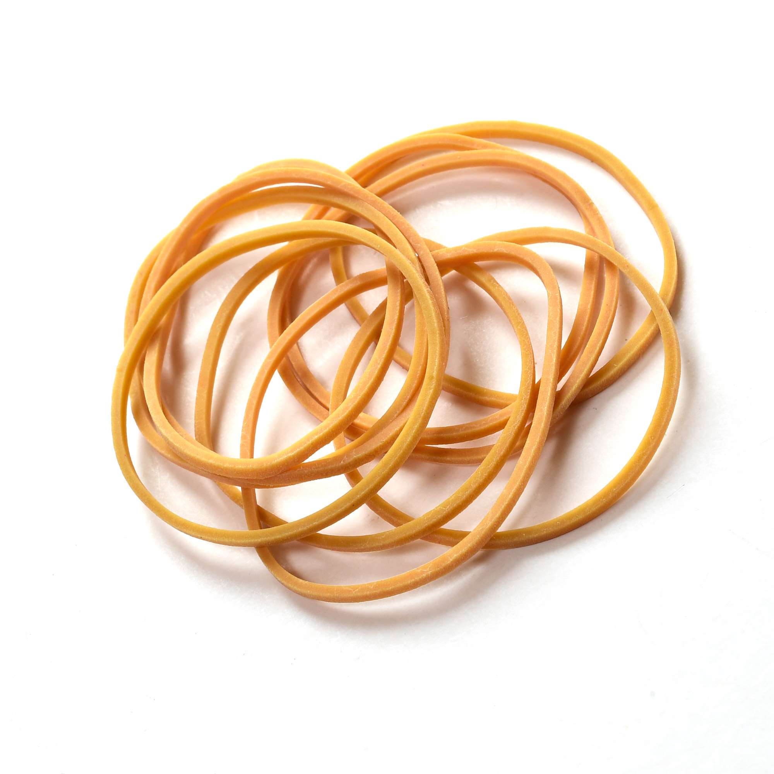
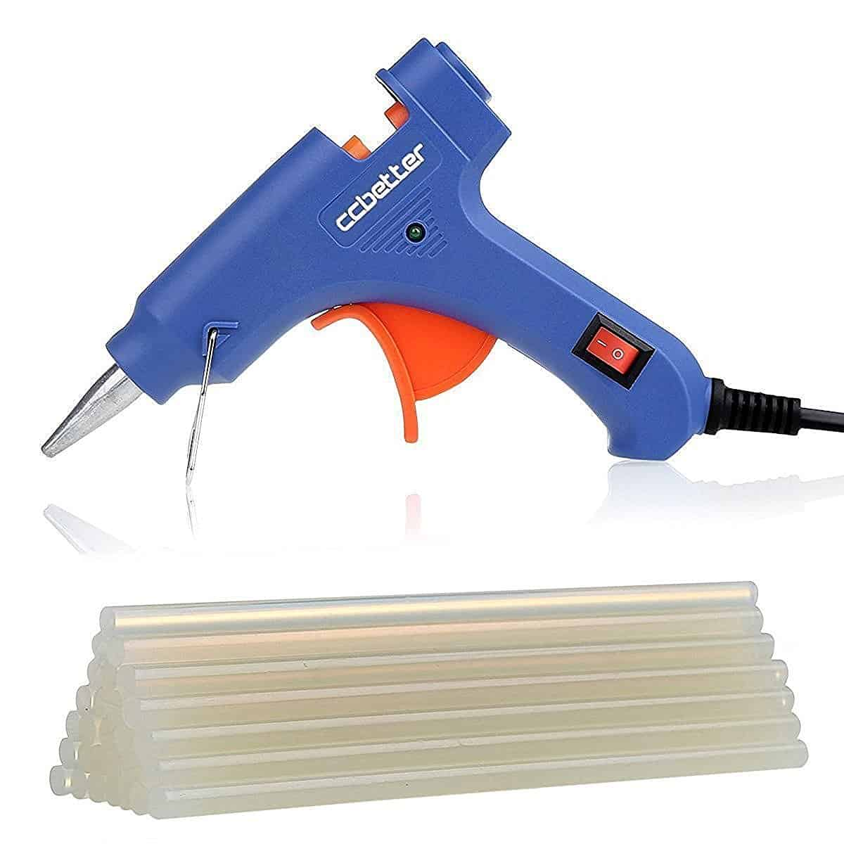
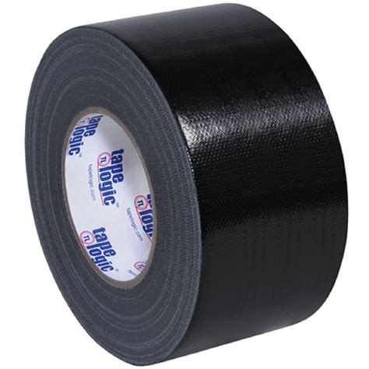
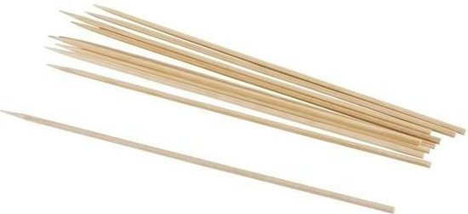
Building materials

Slide 11
Mini-lecture: Basic arduino topics

Slide 12
Basic arduino tutorial and topics
Install the arduino IDE(https://www.arduino.cc/en/software)
Connect your tank to a laptop running the arduino IDE using a blue USB cable
Under ‘tools’ -> ‘board’ select ‘Arduino Mega ADK’
Under ‘port’, select the port the arduino is connected to
Try to upload the testing code provided by us.
If any team has issues with this, please let a board member know
Topics that will be explained:
Motor control using PWM
Serial communication through USB
Serial communication using bluetooth

Slide 13
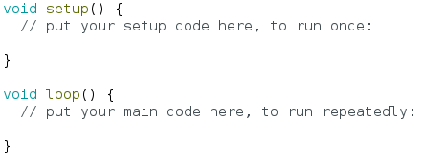
Structure of an arduino program
Setup(): Code that runs once at the start of your program
Used for declaring initial values and pins used by your program
Loop(): Code that runs repeatedly until your arduino is powered off
The actual decision making, sensor reading and motor powering
All arduino programs MUST have these two functions in order to upload them to a board

Slide 14
Motor speed control
With digital pins you can control the average voltage a motor receives from an arduino and with that, the rotation speed of the motors.
Digital pins are pins that have TWO distinct states which can be thought of in the following way
ON or OFF
True or False
HIGH(5 Volts) or LOW(0 Volts)
To ‘control’ the average voltage a motor receives we use something called Pulse-Width-Modulation or PWM for short

Slide 15
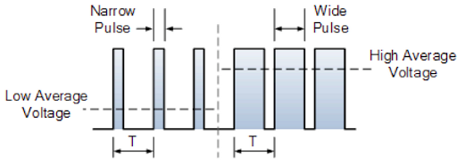
Motor speed control
PWM controls the average voltage a motor receives
Digital pins have two states, 0 and 5 V. By switching on and off between these for a certain time during one period of the signal, you can have different average voltages.
Duty cycle is defined as the percentage of the period T that the voltage stays on. 0% duty cycle is completely off and 100% duty cycle is completely on.

Slide 16
Motor speed with arduino
With an arduino you can specify a duty cycle that a PWM digital pin will output with. Instead of the 0-100 scale it uses the 0-255 scale.
That is done with the analogWrite() function.
TIP: Avoid using 100% duty cycle. Hardware is not perfect and this can cause problems with the electronics.
Not all digital pins can deliver PWM signals. The ones that can have a ‘~’ sign in front of their number.

Slide 17
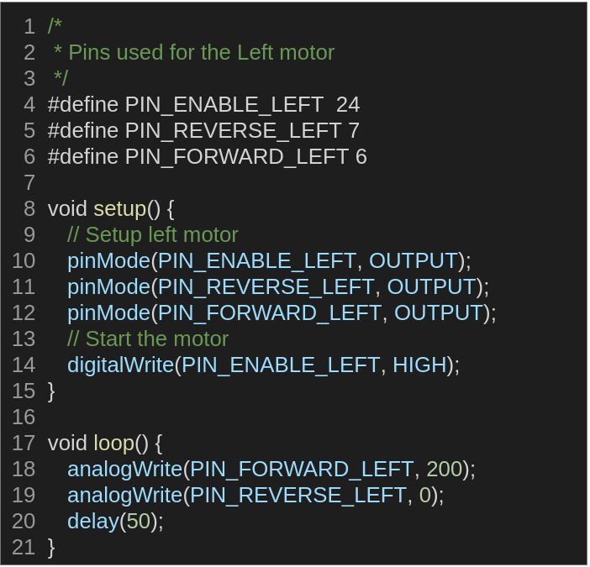
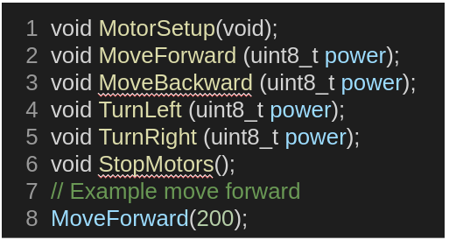
Motor control: Code example
PIN numbers and setup functions are already implemented for both motors.
Basic code for moving forward is provided, but feel free to modify if however you want.

Slide 18
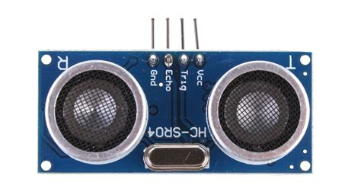
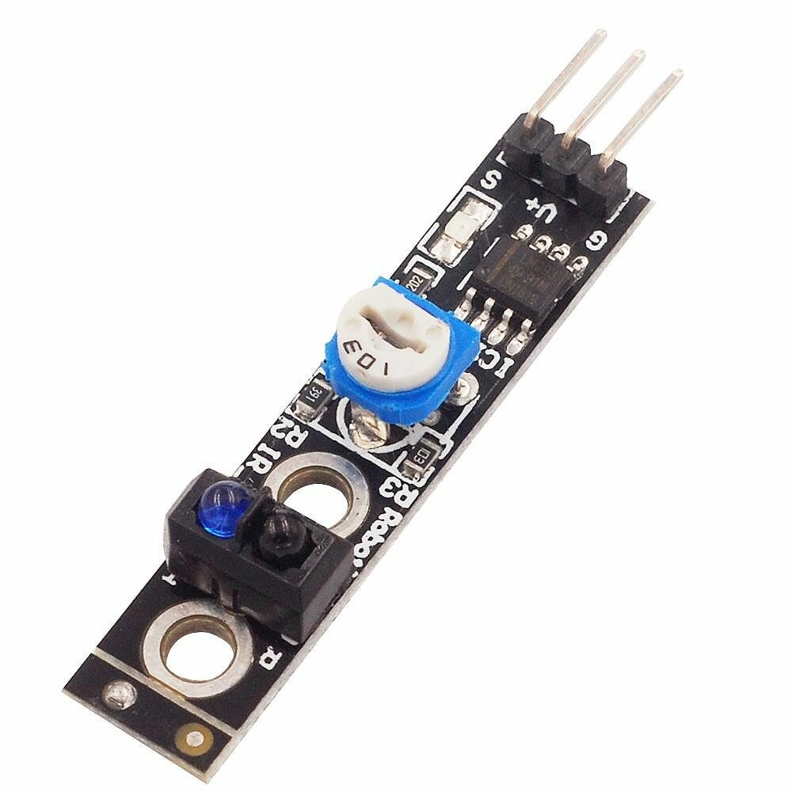
Using sensors
First, not all sensors are born equal. Sensors can have vastly different qualities, working principles and usage.
When it comes to using sensors, instruction manuals and google are your friends
The two sensors that the tanks are equipped with are:
Sonar → Distance sensing
Light sensors → Sensing different colors(Line vs not the line)

Slide 19
Serial communication
For communication, data is transformed to a digital representation
Recall:
The binary number system(ones and zeroes)
Bits -> 1 or 0
Bytes -> sequence of 8 bits
1 byte can represent integers from 0-255
Using the ASCII system you can represent keyboard characters using numbers, which can then be used to send to the arduino.
We will be using this principle for remote control of the arduino
Look up ASCII yourself later if needed
For remote control of an arduino using a keyboard, we need to use python. The program is already provided by us, so no knowledge needed on your part.

Slide 20
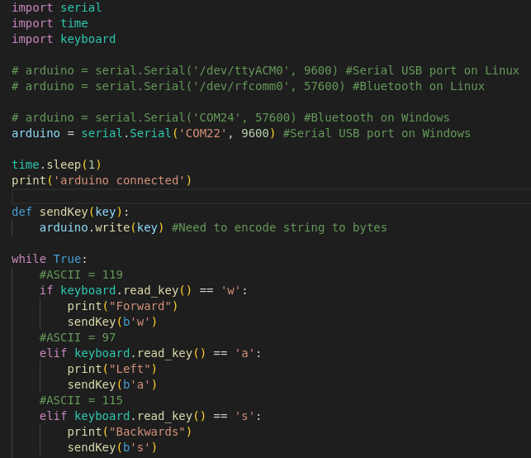
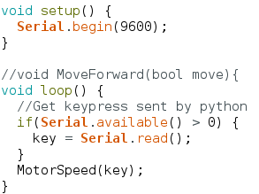
Code example: Wired communication
Python code is provided by us.
Define serial port
Read keyboard presses
Send info if wasd keys are pressed
Arduino receives and changes motor speed

Slide 21
Bluetooth serial communication
Serial communication with bluetooth is essentially the same as wired, only with two 3 extra steps:
Pair your laptop with the tank. Something like ‘Tank (your number here)’
Find the outgoing serial port your bluetooth device is using.
In the code setup() make sure you have Serial1.begin(56700). Which means open the serial port at a baudrate that MUST be 56700

Slide 22
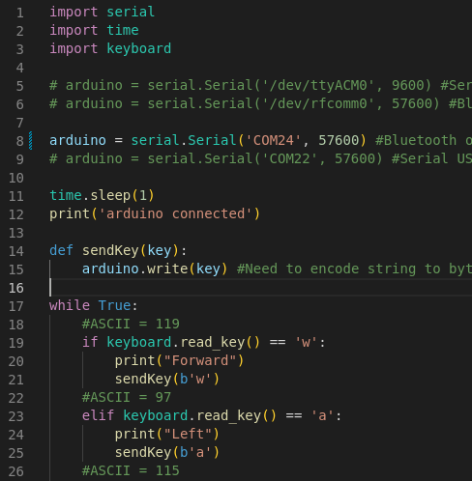
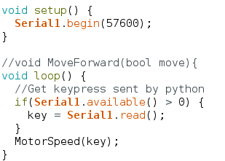
Code example: BT communication
Python code is provided by us.
Define serial port
Read keyboard presses
Send info if wasd keys are pressed
Arduino receives and changes motor speed

